Slide 1

UNIVERSITY INSTITUTEOF ENGINEERING
Bachelor of Engineering (Computer Science & Engineering)
Operating System (CST-328)
Subject Coordinator: Er. Puneet kaur (E6913)
Introduction to Operating System
DISCOVER . LEARN . EMPOWER
Font size 24

Slide 2
Chapter 4
(File Management)
File Concepts, Access Methods, Directory Structure, Allocation Methods, Free Space Management.

Slide 3
Lecture 20
File Structure-
File Operations
&
File Access Methods.

Slide 4
File Structure
None - sequence of words, bytes
Simple record structure
  Lines
  Fixed length
  Variable length
Complex Structures
  Formatted document
  Relocatable load file
Can simulate last two with first method by inserting appropriate control characters
Who decides:
  Operating system
  Program

Slide 5
File Attributes
Name – only information kept in human-readable form
Identifier – unique tag (number) identifies file within file system
Type – needed for systems that support different types
Location – pointer to file location on device
Size – current file size
Protection – controls who can do reading, writing, executing
Time, date, and user identification – data for protection, security, and usage monitoring
Information about files are kept in the directory structure, which is maintained on the disk

Slide 6
File Operations
File is an abstract data type
Create
Write
Read
Reposition within file
Delete
Truncate

Slide 7
Open Files
Several pieces of data are needed to manage open files:
  File pointer: pointer to last read/write location, per process that has the file open
  File-open count: counter of number of times a file is open – to allow removal of data from open-file table when last processes closes it
  Disk location of the file: cache of data access information
  Access rights: per-process access mode information

Slide 8
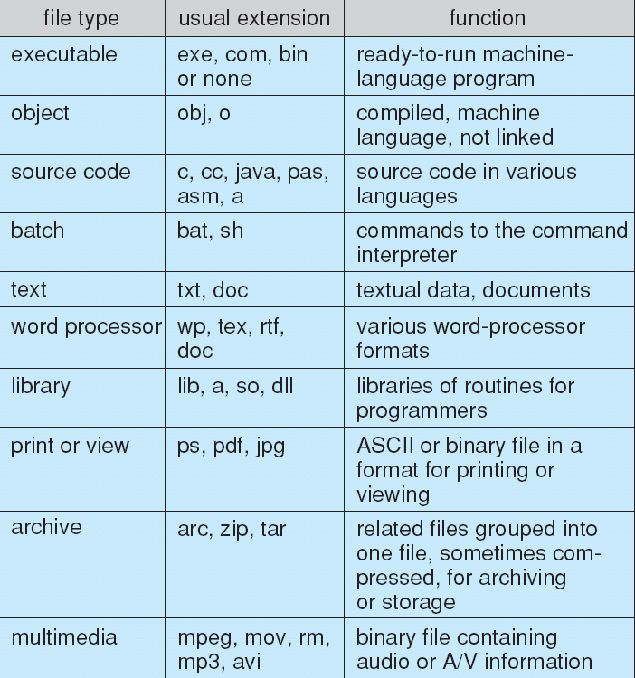
File Types – Name, Extension

Slide 9
Access Methods
Sequential Access
Direct Access

Slide 10
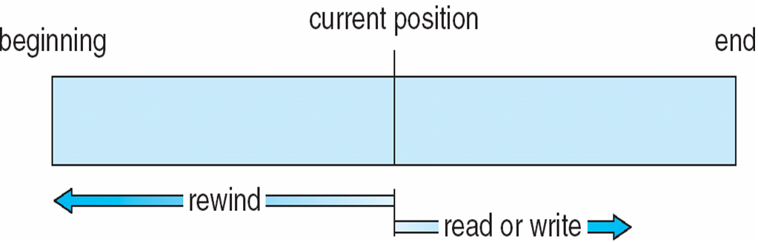
Sequential-access File

Slide 11
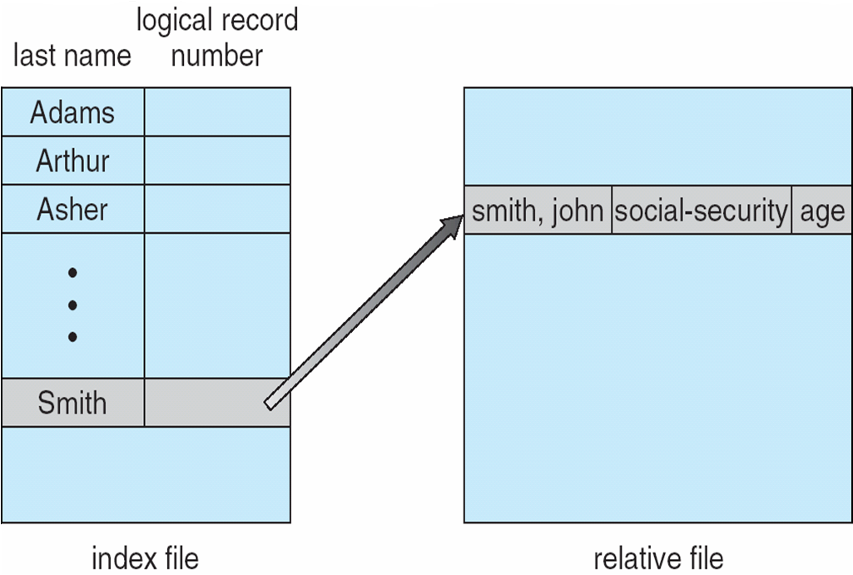
Example of Index and Relative Files

Slide 12
Directory Structure
A collection of nodes containing information about all files
Directory
Files
F 1
F 2
F 3
F 4
F n
Both the directory structure and the files reside on disk
Backups of these two structures are kept on tapes

Slide 13
Disk Structure
Disk can be subdivided into partitions
Disks or partitions can be RAID(Redundant Array of Independent Disks) protected against failure
Disk or partition can be used raw – without a file system, or formatted with a file system
Partitions also known as minidisks, slices
Entity containing file system known as a volume
Each volume containing file system also tracks that file system’s info in device directory or volume table of contents
As well as general-purpose file systems there are many special-purpose file systems, frequently all within the same operating system or computer

Slide 14
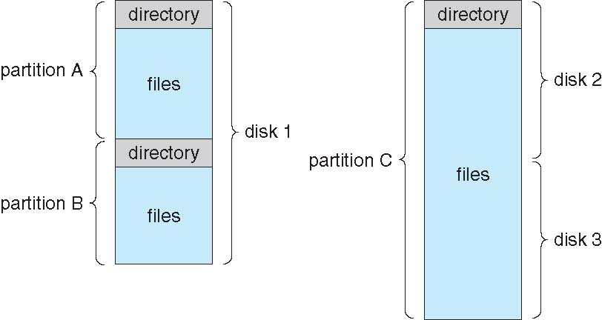
A Typical File-system Organization

Slide 15
Operations Performed on Directory
Search for a file
Create a file
Delete a file
List a directory
Rename a file
Traverse the file system

Slide 16
Organize the Directory (Logically) to Obtain
Efficiency – locating a file quickly
Naming – convenient to users
  Two users can have same name for different files
  The same file can have several different names
Grouping – logical grouping of files by properties

Slide 17
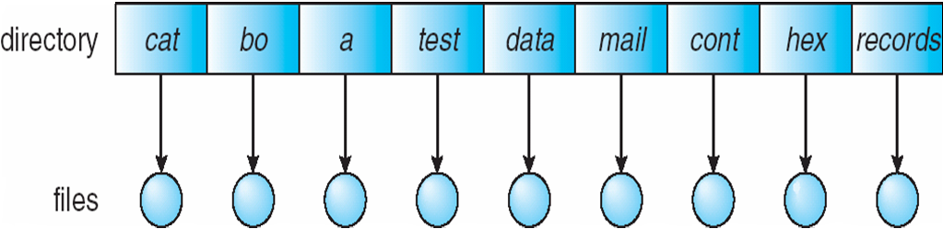
Single-Level Directory
A single directory for all users
Naming problem
Grouping problem

Slide 18
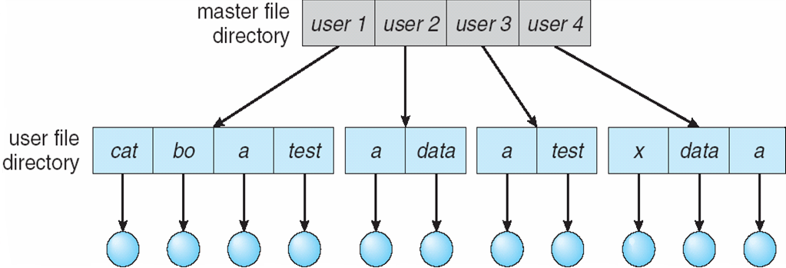
Two-Level Directory
Separate directory for each user
Path name
Can have the same file name for different user
Efficient searching
No grouping capability

Slide 19
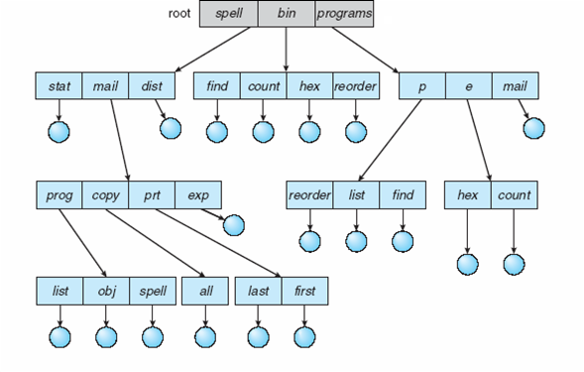
Tree-Structured Directories

Slide 20
Tree-Structured Directories (Cont.)
Efficient searching
Grouping Capability
Current directory (working directory)
  cd /spell/mail/prog
  type list

Slide 21
Tree-Structured Directories (Cont)
Absolute or relative path name
Creating a new file is done in current directory
Delete a file
rm <file-name>
Creating a new subdirectory is done in current directory
  mkdir <dir-name>
Example: if in current directory /mail
mkdir count
mail
prog
copy
prt
exp
count
Deleting “mail” ⇒ deleting the entire subtree rooted by “mail”

Slide 22
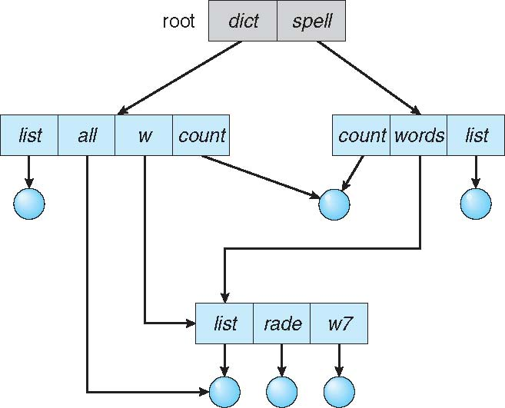
Acyclic-Graph Directories
Have shared subdirectories and files

Slide 23
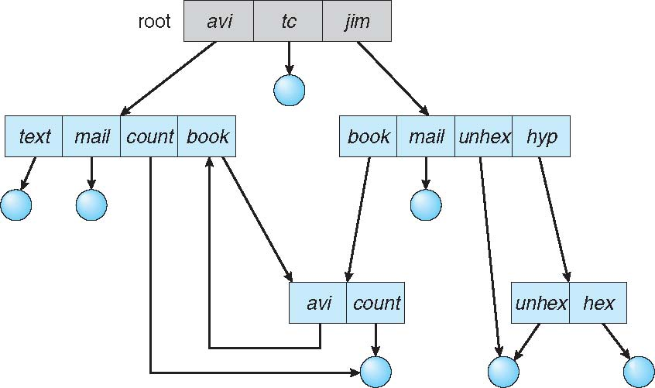
General Graph Directory

Slide 24
Conclusion
This lecture makes the student familiar with File system structures, operation on files, attributes of files and directory structures.

Slide 25
Video Link
https://www.youtube.com/watch?v=vqdTDdHyU5U
https://www.youtube.com/watch?v=xl8a2n63D5s

Slide 26
References
https://www.includehelp.com/operating-systems/file-management-in-operating-system.aspx#:~:text=A%20file%20is%20collection%20of,modifying%20and%20deleting%20the%20files.
https://www.tutorialspoint.com/operating_system/os_file_system.htm
https://www.unf.edu/public/cop4610/ree/Notes/PPT/PPT8E/CH12-OS8e.pdf
https://www.javatpoint.com/os-file-system

